Slide 1
New and Views
Auditors’ Session
Simon Oberst, Director of Quality and Accreditation
Jean-Benoît Burrion, Chair, A&D Board
14th June 2023, Paris Oncology Days, 1830

Slide 2
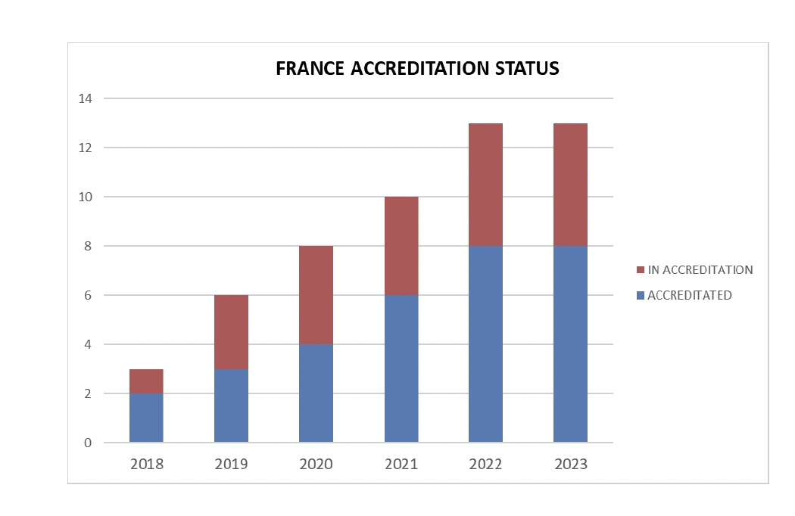
Demand is growing
The last few years have seen big growth in France, Sweden and Finland
Now we see considerable interest in Spain, Ireland, Denmark, Czech republic, Netherlands, Italy, Bulgaria, Slovakia, and others…
We need to think beyond Europe – e.g. South America

Slide 3
Our auditors are our front-line precious resource
In the A&D Programme: 94 active Auditors
10 Directors
21 Nurses / Nurse background
20 Quality Managers
25 Physicians
16 Research background
2 other (pharmacy, psychologist)
Therefore – emphasis on training and refreshment about our processes
We will be recruiting more auditors for a March 2024 training

Slide 4
Planning the future
Expanding the OECI quality and A&D community (within Europe, and beyond)
Our first peer review in South America
Creating more of a sense of community: spreading excellent practices; offering benchmarking
Second round of excellent practices next year
Consolidating and improving the A&D programme
4th review of our standards 2023-25 – even smarter! (Auditors will be fully involved in identifying gaps and getting rid of redundancies)
Concentrating on our added value to centres
Making certain processes more clear
Enlarging the A&D Board – more members and patient expert
Improving our webpages to be more engaging and interactive

Slide 5
Our values and distinctiveness
In the Standards Revision process we want to gain feedback from you, our auditors
In the light of various EU initiatives, including Crane, we want to develop and improve what is distinctive about our quality and accreditation programme:
We believe in peer reviews, not technical audits
Our auditors are all professionals in Cancer Centres from day to day
Our programme is voluntary, not regulatory
We are enabling, not controlling
We can order our affairs and programme as our member experts and scientific findings demonstrate are best standards and practices
We want to be an effective community of practice where we enable each centre to improve, develop and learn from each other.

